Slide 1
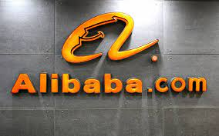
ALIBABA – How does an “ANT” come to end?
Presented by,
Manav Mangukiya
Anusha Manchi
Mansi Bhiwapurkar
Shreya Shree
Ramya Sree

Slide 2
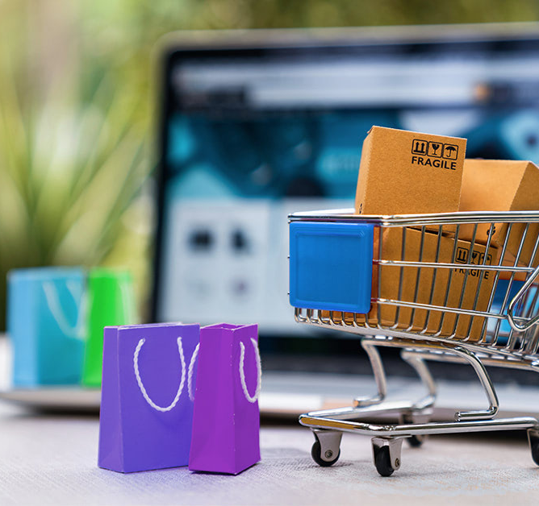
Organization Introduction
Founded: Established in 1999 by Jack Ma in Hangzhou, China.
Business Model: Operates a diverse range of businesses from e-commerce and retail to cloud computing, digital media, and entertainment.
Global Reach: While rooted in China, Alibaba has expanded globally, competing with the likes of Amazon and eBay.
Innovation and Technology: Invests heavily in innovation, AI, and the development of future technologies including logistics and supply chain advancements.
Financial Services: Through its affiliate Ant Group, Alibaba also offers financial services, including wealth management and insurance.

Slide 3
Alibaba’s Subsidiaries
Launched in May 2003
Provides a premium shopping experience
Operates as an international marketplace Specifically designed for business-to-business transactions(B2B) Offers secure payment options, including online transactions and payment protection services.
The online shopping destination of choice for Chinese customers
China’s largest mobile commerce destination by monthly active users in 2022.
Features millions of products and services
Offers top quality branded merchandise
China’s largest 3rd party platform for brands & retailers by monthly active users by 2023.
Launched in April 2008

Slide 4
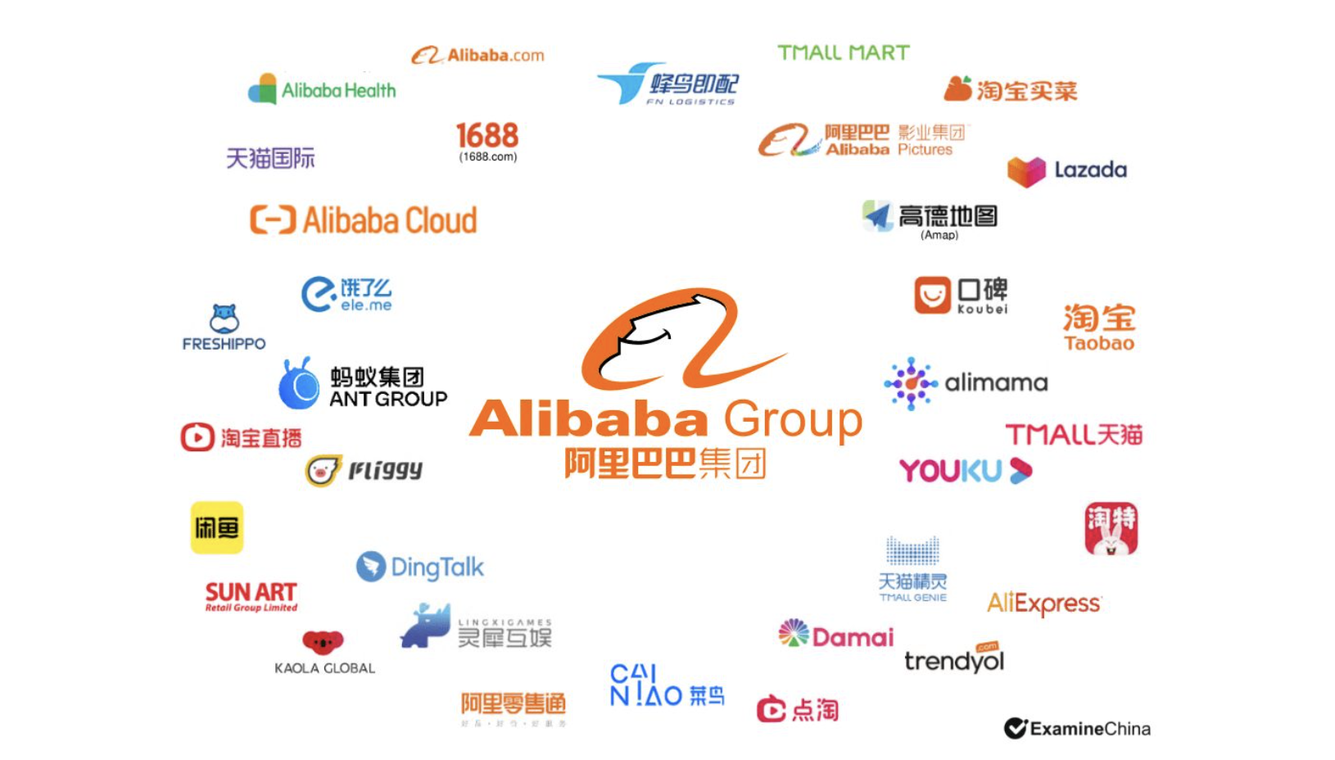

Slide 5
SWOT ANALYSIS
STRENGTHS
Leading position as the largest internet market
Brand popularity & investor trust
Customer Relationship Management
Connected with own pay system ALIPAY
Expanding network orchestrator
WEAKNESSES
Easy to imitate business model
Counterfeits
Influenced by Chinese government
Slow delivery time
Disorderly business platform
OPPORTUNITIES
Government Support/Regulations
Growth in cloud computing and digital services
Leveraging emerging technologies (AI, IoT) for innovation
Increase in delivery efficiency
Strong economic and industrial background
THREATS
Government Regulations/Nationalization
E-commerce competition
Global economic crisis
Economic downturns affecting consumer spending
Lawsuits from brand holders

Slide 6

Business problem
Supply Chain Management
Inventory Management: Track inventory levels in real-time, reducing the likelihood of stockouts or overstocking.
Order Processing: Streamline the order-to-cash process, reducing manual errors and processing times.
Demand Forecasting: Use historical data and analytics to improve accuracy in predicting demand, facilitating better production planning.
Supplier Relationship Management (SRM): Centralize communication with suppliers, enhance collaboration, and negotiate favorable terms.

Slide 7

Customer Service
Cloud Service Outages:
These outages affected database management products such as PostgreSQL, Redis, and MySQL editions
01
Covid-19 Effect:
Affected the availability and delivery of products.
Shipping delays, product shortages, and order cancellations.
02
Loss of Major International Customer:
Slower revenue growth
Lack of communication, trust issue, digital platform engagement.
03

Slide 8
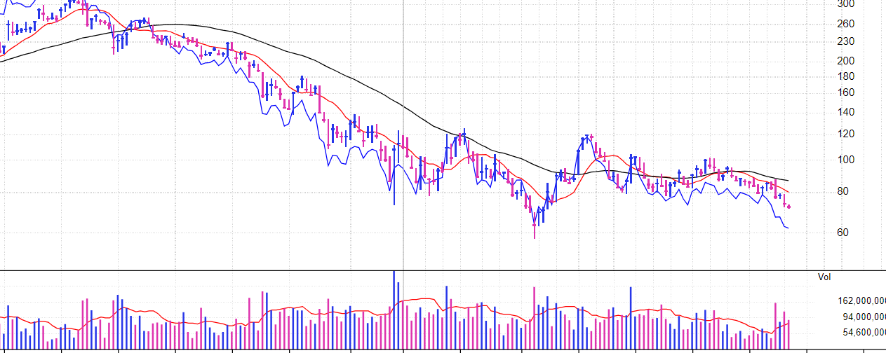
Market breakdown
Alibaba lost 28 Billion USD in 3 months due to service outage.

Slide 9

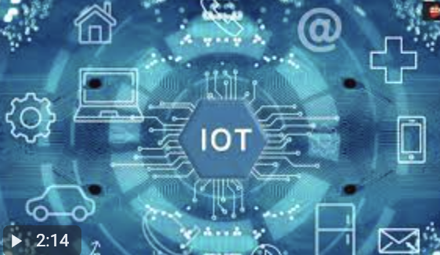


Proposed IS/IT Solutions
Supply Chain Visibility and Management
Real-time Tracking and Monitoring:
IoT sensors can be integrated into products, packaging, and transportation vehicles to provide real-time tracking and monitoring of the entire supply chain.
Predictive Analytics:
By leveraging data collected through IoT devices, Alibaba can implement advanced analytics and machine learning algorithms to predict potential disruptions, optimize routes, and proactively address issues before they escalate.
Inventory and Warehouse Management:
Use IoT devices to monitor inventory levels and automate reorder processes based on demand fluctuations.

Slide 10


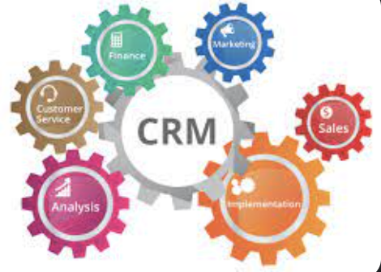
Proposed IS/IT Solutions
Supply Chain Visibility and Management
Chatbots and Virtual Assistants:
Handles routine queries, providing instant responses, and guiding users through common issues.
Online Self-Service Tools:
Enhancement of self-service tools like FAQs, knowledge bases, and troubleshooting guides to find answers.
Customer Relationship Management (CRM) Systems:
Maintains a comprehensive database of customer interactions and transactions, facilitating personalized and efficient assistance.

Slide 11
Key Performance Indicators
On-time Delivery Performance
Supply Chain Response Time
User Adoption
Data Accuracy and Integration
AI Effectiveness
IoT Device Reliability
Platform Engagement

Slide 12
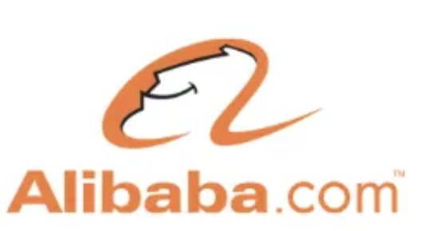




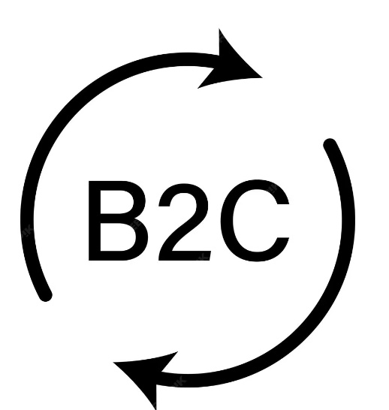
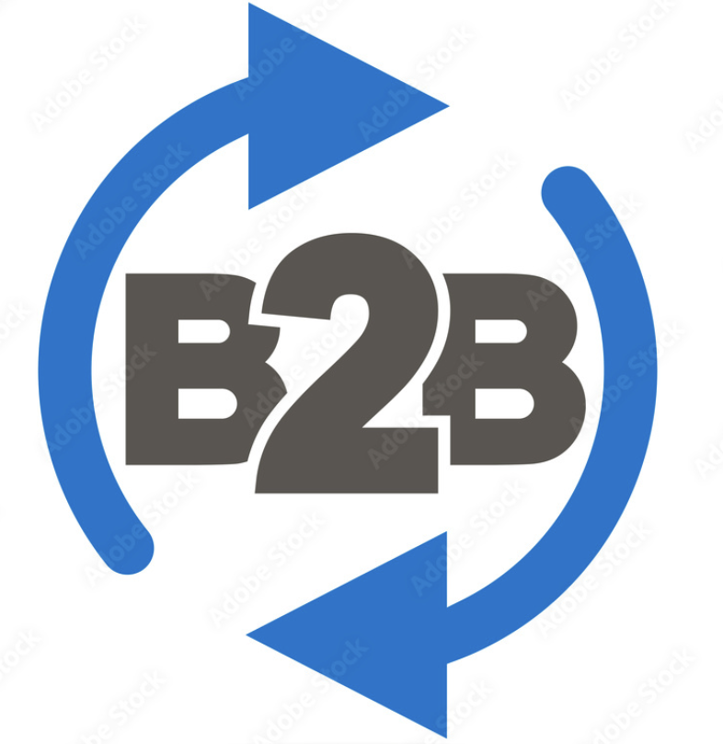






Alibaba Cloud (Aliyun) provides cloud computing and data storage services.
Follows a Business-to-consumer (B2C) model
Employs Alipay, a widely used online payment platform, facilitating secure transactions.
Its revenue includes online and physical stores, third-party seller services, subscription services, and advertising.
Alibaba Pictures is involved in the production and distribution of digital entertainment content.
AWS is a leading cloud services provider globally, offering a wide range of cloud computing solutions.
Follows a direct-to-consumer (B2C) model, selling products directly to customers.
Relies on traditional payment methods and its own payment service, Amazon Pay, PayPal.
Amazon’s revenue includes online and physical stores, third-party seller services, subscription services, and advertising.
Amazon Prime Video provides streaming services and original content production.

Slide 13
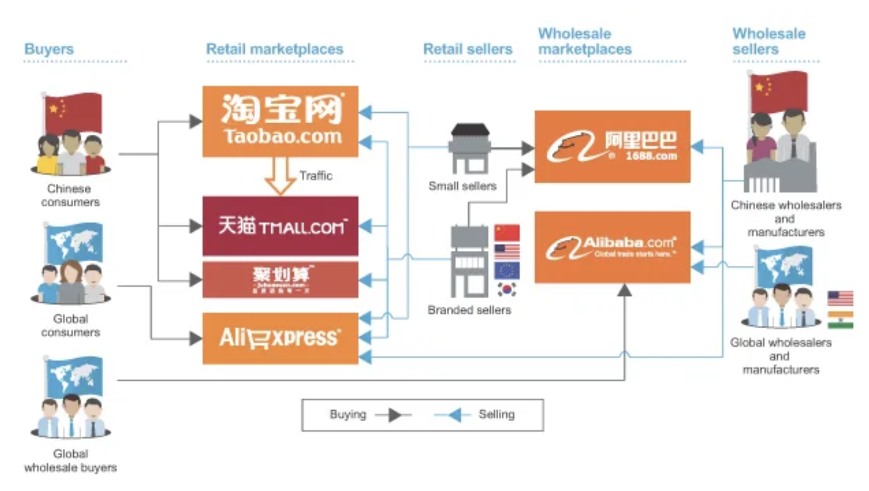
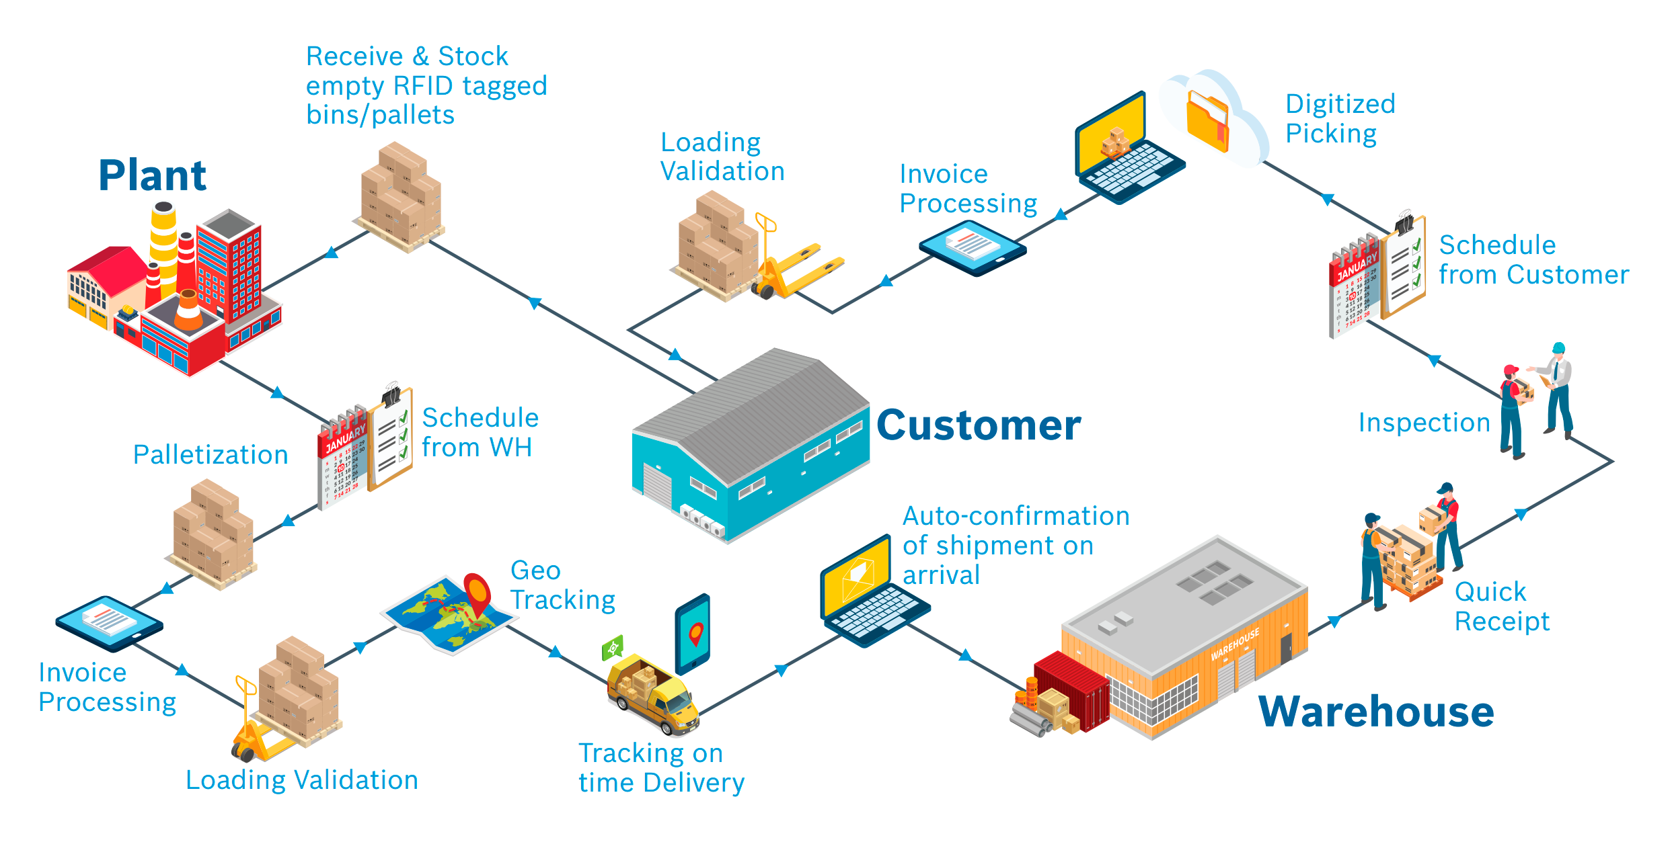
Supply Chain Comparison

Slide 14

Security and Control
Access Controls: Alibaba Cloud has established access management processes, including an access card system and fingerprint access control system. Visitor access to a datacenter and/or server room areas must be requested and approved prior to the visit.
Access Provisioning: Alibaba Cloud has policies and procedures established for logical access management of employee access rights. Alibaba Cloud enforces two-factor authentication to authenticate users of the operations platform.
Data Transmission: Hyper Text Transfer Protocol over Secure Socket Layer (HTTPS) is deployed in the Management Console and Open API gateway. Alibaba Cloud Security Certificate Service, by which tenants can purchase and deploy digital certificates directly through Alibaba Cloud's platform, is provided.

Slide 15
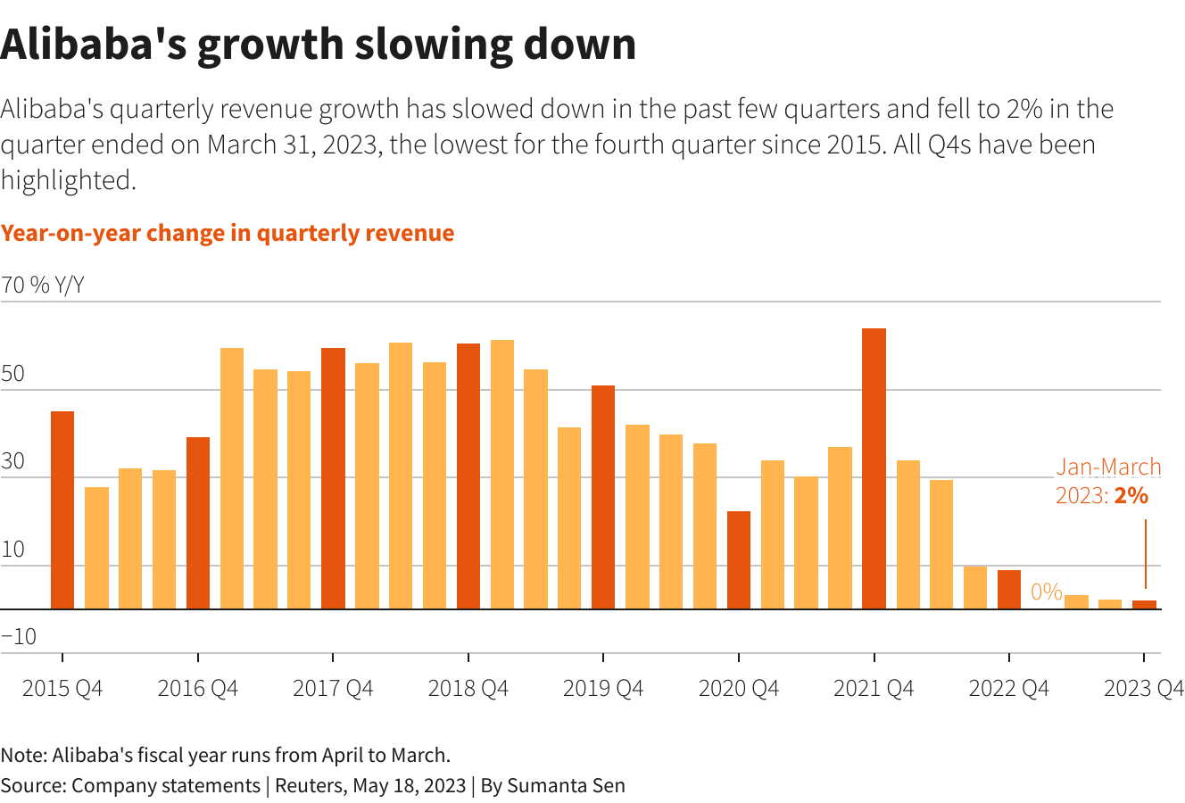
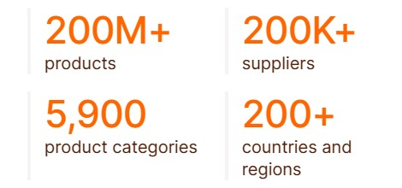
Current Scenario of Alibaba
CEO of Alibaba- Eddie Wu
According to Alibaba's latest financial reports the company's current revenue (TTM) is $129.89 B.
Competitors are Amazon, JD.com, Ebay, Rakuten.
The six newly-formed business units will be: Cloud Intelligence Group, Taobao Tmall Commerce Group, Local Services Group, Cainiao Smart Logistics, Global Digital Commerce Group, and a Digital Media and Entertainment Group.

Slide 16

Conclusion
To enhance its supply chain, Alibaba can integrate cutting-edge technologies such as artificial intelligence (AI) and the Internet of Things (IoT) to improve real-time decision-making
Implement AI-driven chatbots for quick, reliable customer support.
Establish robust feedback channels for continuous improvement based on customer insights.

Slide 17

Thank You!

